Slide 1
Zeek dictionary performance improvement
Zeek week 2019
Jason lu – Senior staff software engineer
Icebrg/Gigamon insight

Slide 2
bio
Mostly C++ developer, some python/java/go projects
1 year in network security industry with ICEBRG/GIGAMON INSIGHT
10 years in financial industry building high frequency trading platforms
5 years with Fabless Video chip startup.
3 years with Microsoft MSTV group

Slide 3
agenda
Reproduce Zeek dictionary memory efficiency issue quickly and consistently
Zeek dictionary stats under stress
New clustered hashing dictionary
Measurement & Comparison

Slide 4
reproduce zeek memory efficiency issue
Observation
Zeek grows in memory over time in production.
Grows faster when SMB packets is abundant
Objective
Reproduce it quickly
Reproduce it consistently

Slide 5
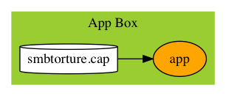
Feed smbtorture.cap directly to zeek
Grab smbtorture.cap from wireshark sample pcaps
Feed smbtorture.cap directly to zeek
Problem
Failed to reproduce the memory issue
Reason
We lack some intensity

Slide 6
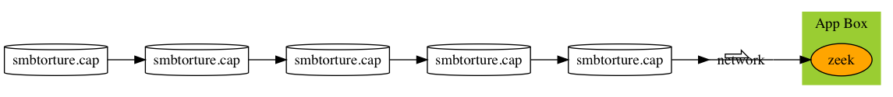
Add some intensity by repeat@speed
Tcpreplay: The tool to repeat packets serially
Problem
Failed to reproduce memory issue quickly
Reason
Intensity not enough

Slide 7
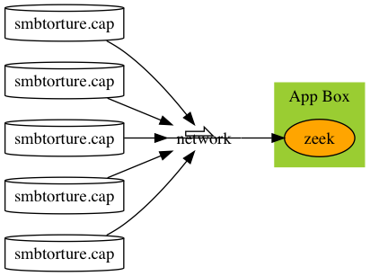
increase intensity EVEN MORE - repeat in parallel - highly mixed packets with randomized ip pairs

Slide 8
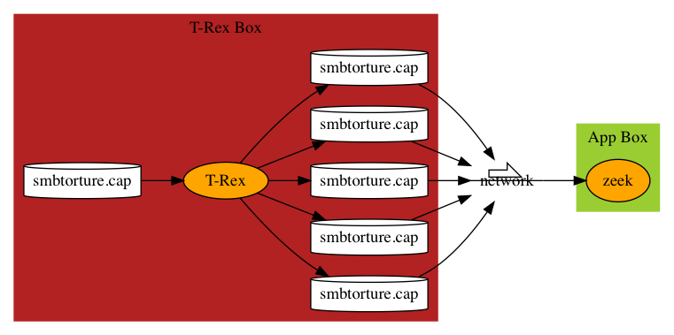
T-rex: The tool to repeat in parallel
Problem
T-Rex only accepts pcaps from the same session
Same session = same IP/Port pair.
Notes:
NIC Function
#1 NAT NIC for ssh
#2 The port to be used to capture network traffic
#3 Client port, t-rex sends requests from this NIC
#4 Server Port, t-rex receives requests and sends responses on this NIC

Slide 9
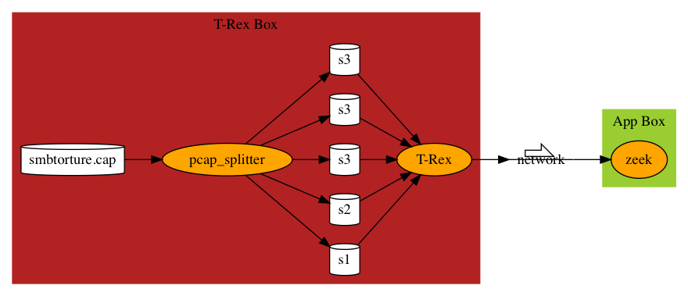
THE FIX: PCAP_SPLITTER
Pcap_splitter to split source pcap into a series of pcaps
Each pcap belong to the same session.

Slide 10
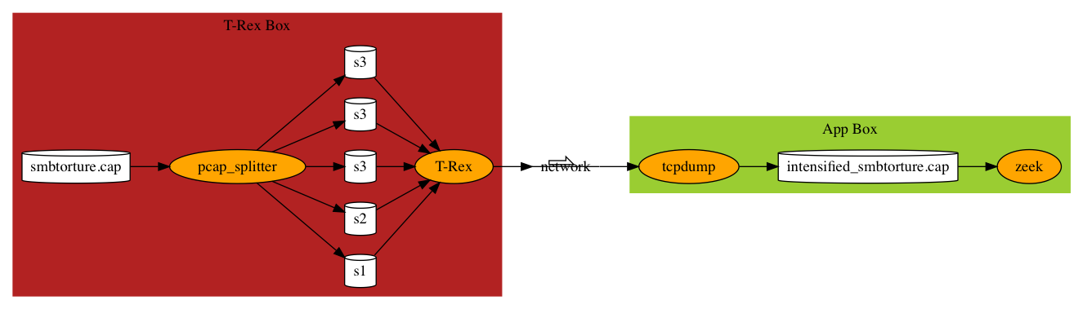
Remove asynchronicity
Feed the application with random packets asynchronously not debug friendly
Record output from T-Rex output by tcpdump
Feed recorded, intensified packet captures directly to the app

Slide 11
Reproduce zeek dictionary MEMORY efficiency issue
Use smbtorture.cap from wireshark as the seed packet
Generate intensified packet captures with 10K, 100K and 1M packets.
Generate through split-trex-tcpdump procedure
Feed 10K.pcap, 100K.pcap and 1M.pcap directly to Zeek
Reproduce Zeek memory performance issue in minutes

Slide 12
Zeek dictionary
~1000 dictionaries are used by zeek core
event engine
script engine
The rest are used by Zeek scripts
Table is dictionary internally
pending_cmds : table[count] of CmdInfo &read_expire=1min;
Set is dictionary internally
recent_files : set[string] &read_expire=3min;

Slide 13
Zeek dictionary Memory stats
Input | 10K.pcap | 100K.pcap | 1M.pcap
# of Dictionaries | 53,933 | 448,701 | 770,463
Zeek Malloc’d Memory (M) | 144 | 816 | 1,672
Dictionary Memory (M) | 13 | 104 | 252
Dictionary Memory per Key (bytes) | 525 | 734 | 601
Dictionary Memory Of Total App(%) | 9.03% | 12.75% | 15.07%
Zeek uses a huge number of dictionaries.
Most dictionaries are created by scripts, same lifespan as sessions
Dictionary memory usage is a big part of total memory usage
Dictionary memory usage per key is large, room for improvement.

Slide 14
Sizes of dictionaries
# of Dictionary Size | 10K.pcap | 100K.pcap | 1M.pcap | % (1M.pcap)
0 | 37,991 | 318,045 | 424,433 | 55.09%
1 | 15,576 | 128,566 | 303,966 | 39.45%
2 | 201 | 1,896 | 31,444 | 4.08%
3 | 26 | 30 | 8,227 | 1.07%
4 | 17 | 18 | 775 | 0.10%
5 | 14 | 13 | 957 | 0.12%
6 | 12 | 22 | 319 | 0.04%
7 | 6 | 6 | 27 | 0.00%
8+ | 90 | 105 | 315 | 0.04%
total | 53,933 | 448,701 | 770,463 | 100.0%
Notes:
Zeek framework uses close to 1000 dictionaries.
Zeek scripts are the majority users of dictionaries.
Field_name_map: table[string] of string
Include: set[string]

Slide 15
# of Dictionary of different sizes
Most dictionaries are small: 55% empty, 40% with 1 element
Reduction of memory usage in small dictionaries can be effective.

Slide 16
ZEEK DICTIONARY: Chained Hashing Variation
hash table
bucket array
0
bucket_ptr
1
2
entry_ptr
3
key_ptr
4
key
5
key_len
hash
6
value_ptr
value
entry
Empty slots in hash table
Empty slots in bucket array
pointers use memory: bucket_ptr, entry_ptr, key_ptr

Slide 17
CLUSTERED Hashing
Fold keys in the bucket array into hash table directly to avoid pointers
Increase the load factor, especially for small dictionaries, to have less unused spaces in hash table while not hurting speed.
100% load factor for dictionaries 11 or less
Resize only if the current table cannot hold the newly inserted item
75% for larger dictionaries.

Slide 18
Fold chain into table
Clustered
index | bucket | distance | key
0
1
2
3
4
5
6
7
8
9
10
11
12
13
Chained
Cluster 0
0
Index=bucket
0
1
2
3
4
5
6
7
8
9
chain 0
10
Cluster 1
10
0
0
Cluster 2
chain 1
1
11
11 | 21
1
21
1
1
2
2
2
chain 2
2
12 | 22 | 32
12
22
32
3
Cluster 7
0
chain 7
1
7
7
7
7
17
27
37
47
17 | 27 | 37 | 47
2
3
For easy illustration, bucket(key) = key % 10, i.e., last decimal digit
distance: how far away the key’s index from its bucket
distance = index - bucket
Notes:
Index is not necessarily bucket anymore, so maintain separate bucket information
Distance is the offset from its current index to its bucket index
Distance = Index - Bucket
Index = Bucket + Distance
Bucket can be derived from Distance, so only Distance is maintained
Overflow area (of lgN) at the end of table to hold the last a few clusters.

Slide 19
Clustered hashing structure & properties
Items of the same bucket clustered together
Cluster is located at or after its bucket
Clusters are arranged in the order of its bucket
No gaps between bucket and head of cluster
No gaps inside the cluster
Overflow area at the end of the table

Slide 20
Clustered hashing - lookup
index | bucket | distance | key
0 | 0 | 0 | 10
1 | 1 | 0 | 11
2 | 1 | 1 | 21
3 | 2 | 1 | 12
4 | 2 | 2 | 22
5 | 2 | 3 | 32
6 | - | - | -
7 | 7 | 0 | 17
8 | 7 | 1 | 27
9 | 7 | 2 | 37
10 | 7 | 3 | 47
11
12
13
Lookup(key)
bucket = Bucket(key)
Start from index I = bucket
If table[i].bucket == bucket && table[i].key == key
Found, I is position
Table[i].bucket > bucket or empty
Not found, i is insert_position
Lookup(22)
Found, index = 4
Lookup(42)
Not found, index stopped at 6.
Index 6 is its insert position
insert_position is the end of the key’s cluster.
Lookup(22)
2
1
Lookup(42)
2
2
2
22
2
-

Slide 21
Clustered hashing – insert(key)
Lookup(key) for position. If key exists, replace the value and done.
If key doesn’t exist, we get insert_position
If table[insert_position] is not empty
Relocate table[insert_position] from the head of its cluster to the end of its cluster, recursively , adjust distance according
Put key in table[insert_position]
Adjust distance accordingly
index | bucket | distance | key
0 | 0 | 0 | 10
1 | 1 | 0 | 11
2 | 1 | 1 | 21
3 | 2 | 1 | 12
4 | 2 | 2 | 22
5 | 2 | 3 | 32
6 | - | - | -
7 | 7 | 0 | 17
8 | 7 | 1 | 27
9 | 7 | 2 | 37
10 | 7 | 3 | 47
11
12
13
1
1
0
0
0
11
50
Insert(50)
Relocate 11
2
1
12
2
Relocate 12
4

Slide 22
Clustered hashing – remove(key)
Index = Lookup(key)
Not found, done
Found
Remove(index), table[index] now empty.
Repeat
If table[index+1] empty, done
If table[index+1].distance == 0, done
Find the tail of cluster table[index+1] belongs.
Move table[tail] to index, making it head of its cluster.
Adjust distance accordingly
Set index = tail as tail is now empty
index | bucket | distance | key
0 | 0 | 0 | 10
1 | 1 | 0 | 11
2 | 1 | 1 | 21
3 | 2 | 1 | 12
4 | 2 | 2 | 22
5 | 2 | 3 | 32
6 | - | - | -
7 | 7 | 0 | 17
8 | 7 | 1 | 27
9 | 7 | 2 | 37
10 | 7 | 3 | 47
11
12
13
Remove(11)
-
-
-
0
Relocate 21
1
1
-
-
-
0
21
2
Relocate 32
2
-
32
2
-
3
-

Slide 23
More ZEEK DICTIONARY Requirements
Incremental Resizing
https://jasonlue.github.io/algo/2019/09/03/clustered-hashing-incremental-resize.html
Modify on Iteration
https://jasonlue.github.io/algo/2019/09/10/clustered-hashing-modify-on-iteration.html

Slide 24
Measurements – chained vs clustered
How much space can it save?
Will it sacrifice time for space?

Slide 25
Single dictionary memory – TCP connections dict
Dictionary size | 1 | 10 | 100 | 1000 | 10K | 100K
Chained Dict(byte/key) | 496 | 217 | 125 | 131 | 139 | 130
Clustered Dict(bytes/key) | 136 | 73 | 73 | 89 | 79 | 102
Faction of Memory(%) | 27% | 34% | 58% | 68% | 57% | 78%

Slide 26
Memory by all dictionaries
Input pcap file | 10K.pcap | 100K.pcap | 1M.pcap
Chained Dict (M) | 13 | 104 | 252
Clustered Dict(M) | 4 | 32 | 62
Faction of Memory (%) | 30% | 31% | 25%
Overall memory savings is big because most of the dictionaries are small (<10)

Slide 27
Memory savings on overall application
malloc’d memory (M) | 10K.pcap | 100K.pcap | 1M.pcap
zeek with chained dict | 144 | 816 | 1,672
zeek with clustered dict | 135 | 749 | 1,499
less memory(M) | 9 | 67 | 173
less memory(%) | 6.25% | 8.21% | 10.35%

Slide 28
Time of single dictionary by size - insert
Perform similarly with mid-size (~1000) dictionaries
Clustered dictionary faster with small dictionaries (<100), ~30% faster
Pointer indirection big part of algo time
Clustered dictionary faster with large dictionaries (>10K), ~30% faster
Pointer indirection causes cache miss

Slide 29
Time by single dictionary - success lookup
Similar to insert
100K, clustered dict perform worse, because clustered dict is in transitory period of incremental resizing.

Slide 30
Time by single dictionary - failed lookup
Similar to insert
Usually faster than successful lookup
As it avoids key comparison most of time
Because buck comparison fails, or
Hash comparison fails

Slide 31
Time by single dictionary - remove
Similar to insert

Slide 32
Time by all dictionaries
Hard to measure
Since most dictionaries are small, it’s estimated that the speed is around speed of dictionary size between 1 and 10, that’s ~30%.

Slide 33
Time savings by application
processing time (s) | 10K.pcap | 100K.pcap | 1M.pcap
zeek with chained dict | .25 | 2.13 | 13.23
zeek with clustered dict | .24 | 2.02 | 12.41
less time (s) | .01 | .11 | .82
less time (%) | 4.00% | 5.16% | 6.20%

Slide 34
conclusion
Clustered Hashing dictionaries as a whole use 1/3 of memory, and perform 30% or more faster under stress.
Contributes to overall Zeek appication 6-10% memory savings and 4-6% speed boost under stress.

Slide 35
Questions?
Don’t have enough time to present details of clustered hashing
Details of the presentation and formal proof and detailed implementation in clustered hashing are presented in a series of posts at jasonlue.github.io
Get the source code, measure it by yourself
Tools and scripts required for the presentation | Github.com/jasonlue/zeek.test
Zeek with clustered hashing dictionary | Github.com/jasonlue/zeek, branch: topic/jasonlue/open_dict
Zeek with clustered hashing dictionary and dictionary stats | Github.com/jasonlue/zeek, Branch: topic/jasonlue/dict_stats
Pcap splitter golang source code | Github.com/jasonlue/go

